Slide 1
Massachusetts: Working to Solve the Transportation Challenge
David Hoff, ICI
Rachel Fichtenbaum and Jenna Henning, MassMobility
March 20, 2019

Slide 2
Who are we?
MassMobility
Joint initiative of two state agencies
Increase mobility for people with disabilities, older adults, low-income commuters, veterans, and others who lack access to transportation
Share info about existing options & assist organizations in implementing new solutions
Statewide
Community transportation approach
www.mass.gov/orgs/massmobility
ICI
Training, technical assistance, research, and direct service organization focused on inclusion of people with disabilities into mainstream society, based at UMass Boston
Providing ongoing support to DDS employment efforts
Focus on transportation issues in Massachusetts and nationally
www.communityinclusion.org
www.employmentfirstma.org

Slide 3
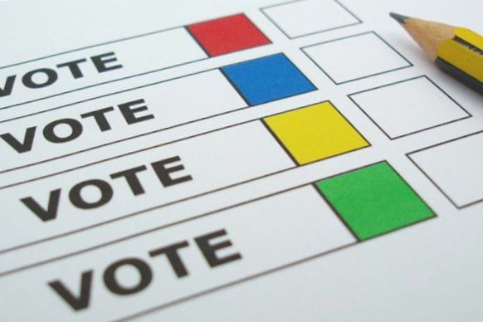
Welcome!
Poll: what’s your region or service area?

Slide 4
A Six-Pronged Approach
Transportation Solutions
Use existing resources differently
Become aware of existing options
Change the transportation mindset
Develop relationships with transportation officials
Work with other groups experiencing transportation challenges
Build transportation competency of service providers

Slide 5
Become aware of existing options

Slide 6
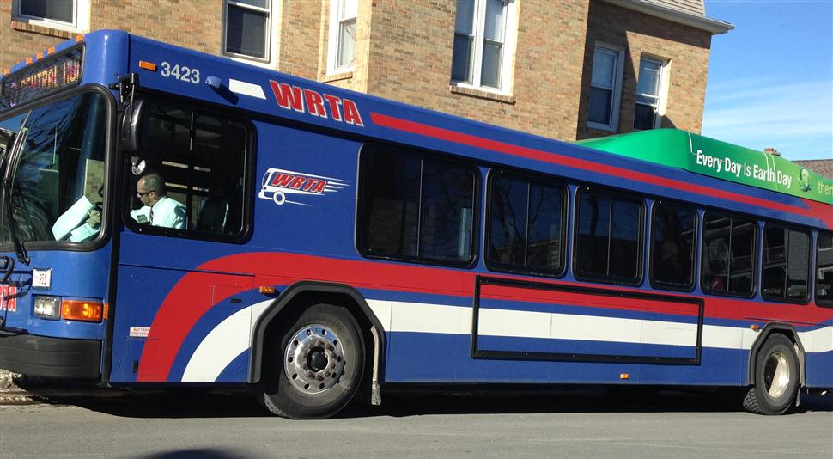
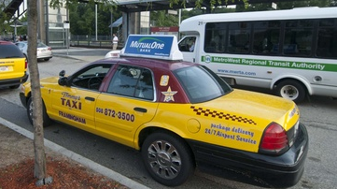
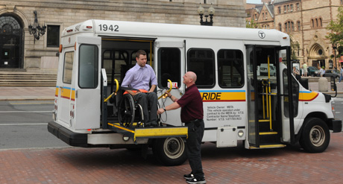
Community Transportation
All transportation resources in a community that are available to help meet community mobility needs

Slide 7

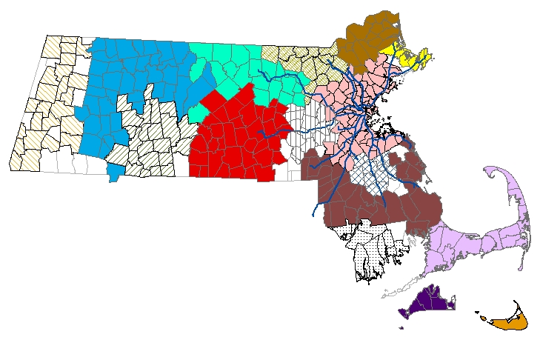
Public transit
Transit
  Fixed-route
    Transportation Access Pass
    Travel training
  Paratransit
  www.mass.gov/info-details/
  public-transportation-in-massachusetts

Slide 8
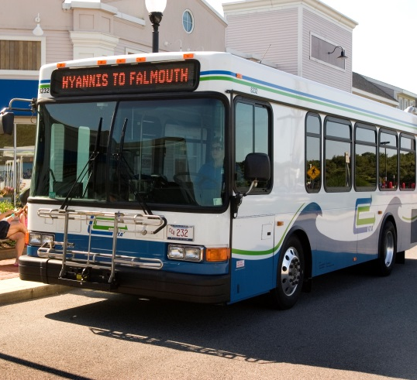
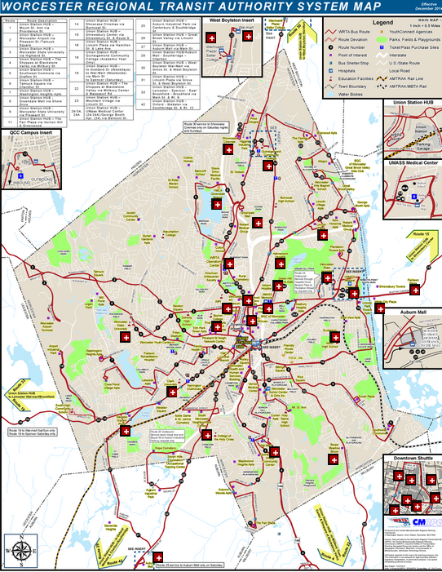
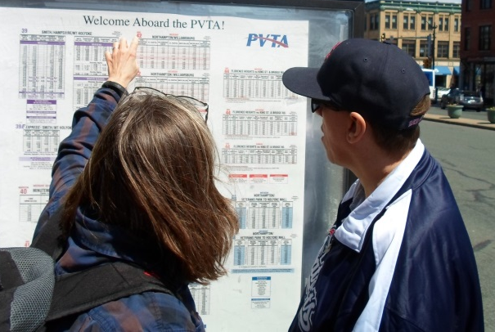
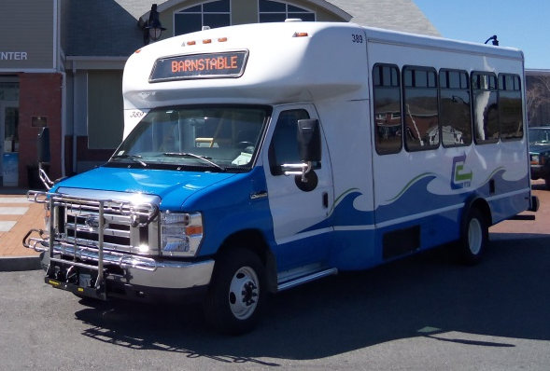
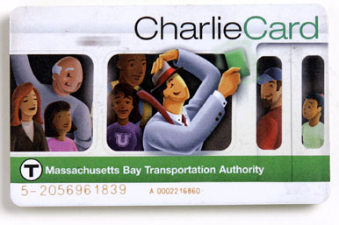
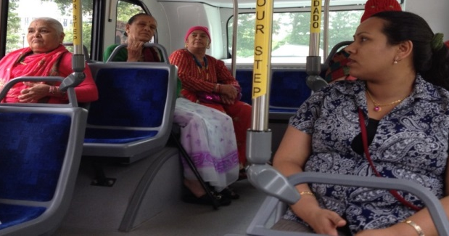
Travel Instruction
The professional activity of teaching individuals with disabilities, seniors, and others how to use fixed-route public transportation independently and safely

Slide 9
Refer Consumers to Travel Instruction
  www.mass.gov/service-details/learn-to-ride-transit-with-travel-instruction
Transit Authority | Contact Information
Berkshire Regional Transit Authority | www.berkshirerta.com/traveltraining.php
Cape Cod Regional Transit Authority | (508) 775-8504 ext. 201
Greater Attleboro Taunton Regional Transit Authority | (508) 823-8828, ext. 225
Martha’s Vineyard Regional Transit Authority | (508) 693-9440
MBTA | https://mbta.com/accessibility/travel-instruction-training
Merrimack Valley Regional Transit Authority | (978) 469-6878
MetroWest Regional Transit Authority | www.mwrta.com/programs/transitions-travel-training
Montachusett Regional Transit Authority | www.mrta.us/how_to_ride/travel-training
Pioneer Valley Transit Authority | pvta.com/travelTraining.php
Worcester Regional Transit Authority | www.wrtaparatransit.com/wrta-travel-training.htm

Slide 10
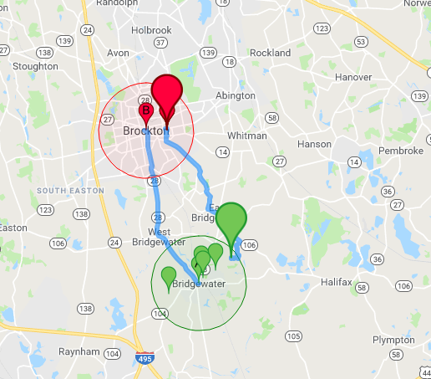
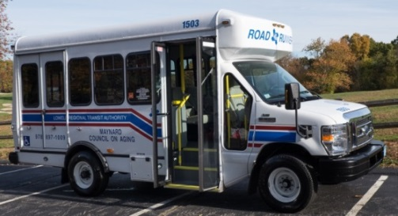

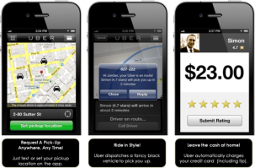
Other Transportation Options
Municipal Services
Councils on Aging
Volunteer Driver Programs
Taxis and On-Demand Services
Find a carpool with Bay State Commute baystatecommute.com
Intercity bus
www.mass.gov/im-looking-for-transportation

Slide 11
Changing the transportation mindset

Slide 12
“It’s more than just the van.”
Disability Services, Inc

Slide 13

Employment
Transportation
Day Service Transportation

Slide 14
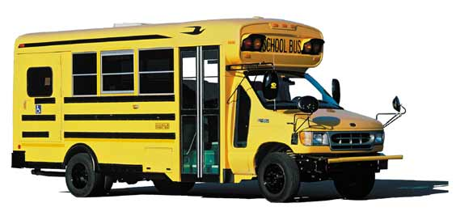
Transportation:
Avoiding Passive Dependence & Acceptance
Starting from an early age if possible, individuals and families:
recognize the relationship of transportation to independence, integration, inclusion
have the tools to use a range of transportation options
learn to actively self-advocate for and self-manage transportation rather than being a passive recipient

Slide 15

Chat Box!
Tell us about a creative transportation solution you’ve developed.

Slide 16
Build the transportation competency of service providers

Slide 17

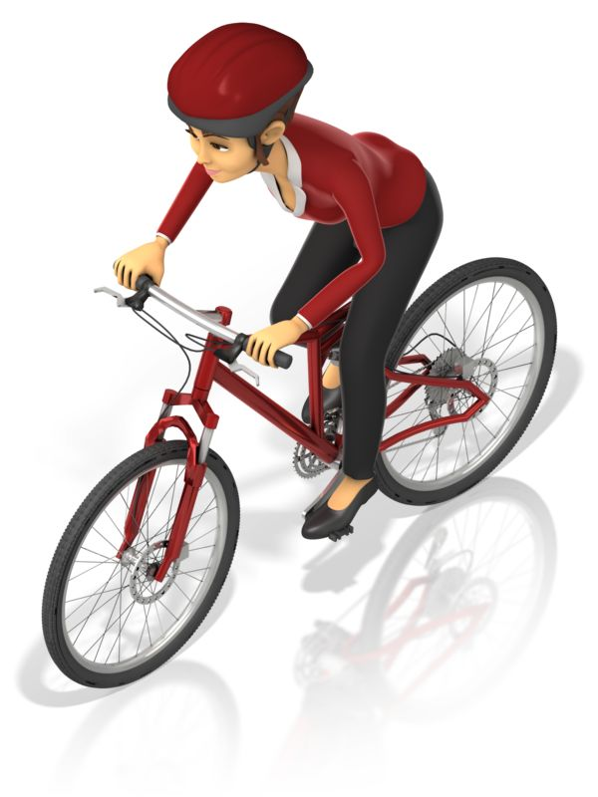
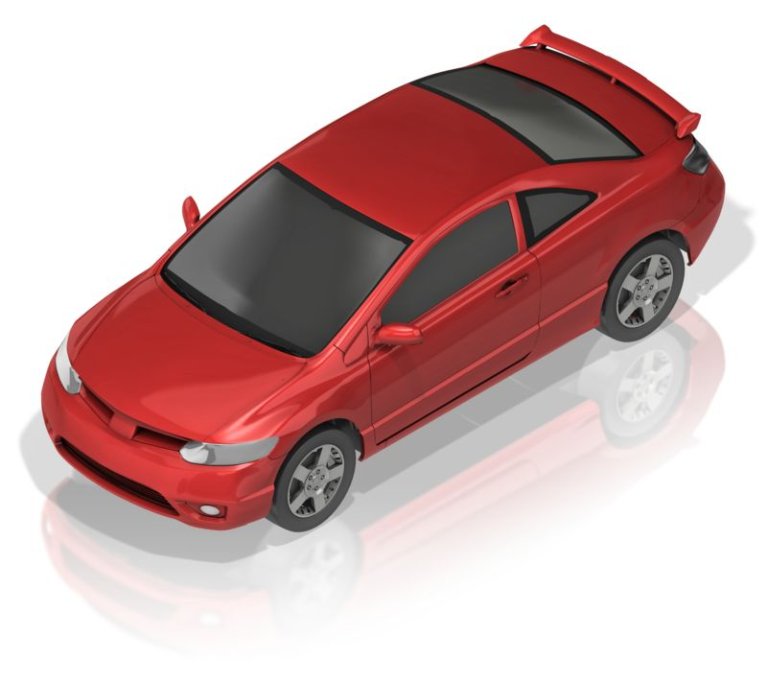
Service Provider Role
Full understanding of transportation options
Facilitating individualized, self-determined approach to transportation that:
  maximizes independence
  makes efficient and effective use of resources
Travel instruction
Transportation partnerships

Slide 18
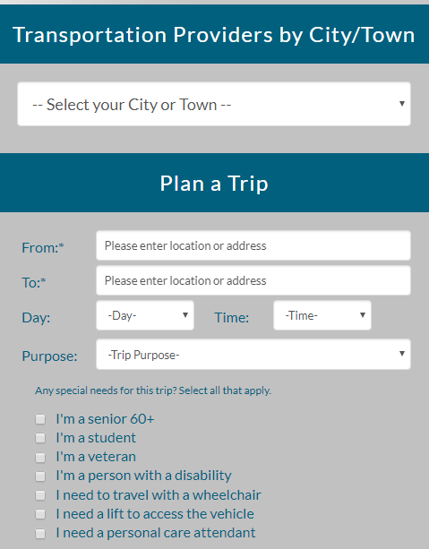
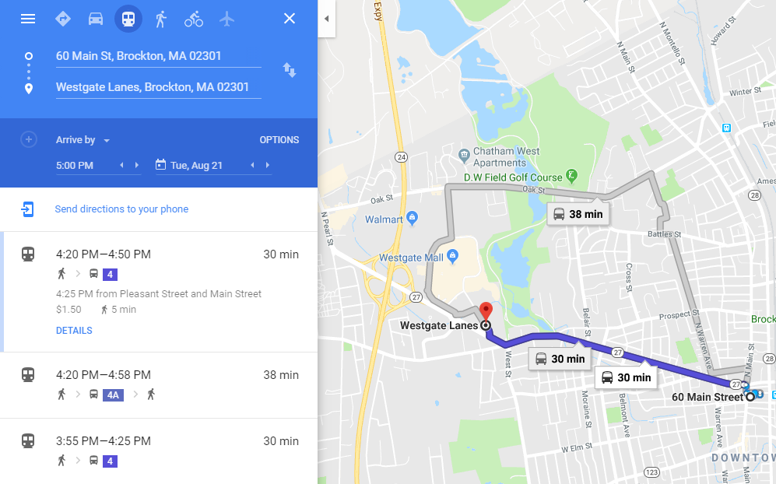
Tools for navigating the options
Google Transit
maps.google.com
Ride Match
www.massridematch.org

Slide 19
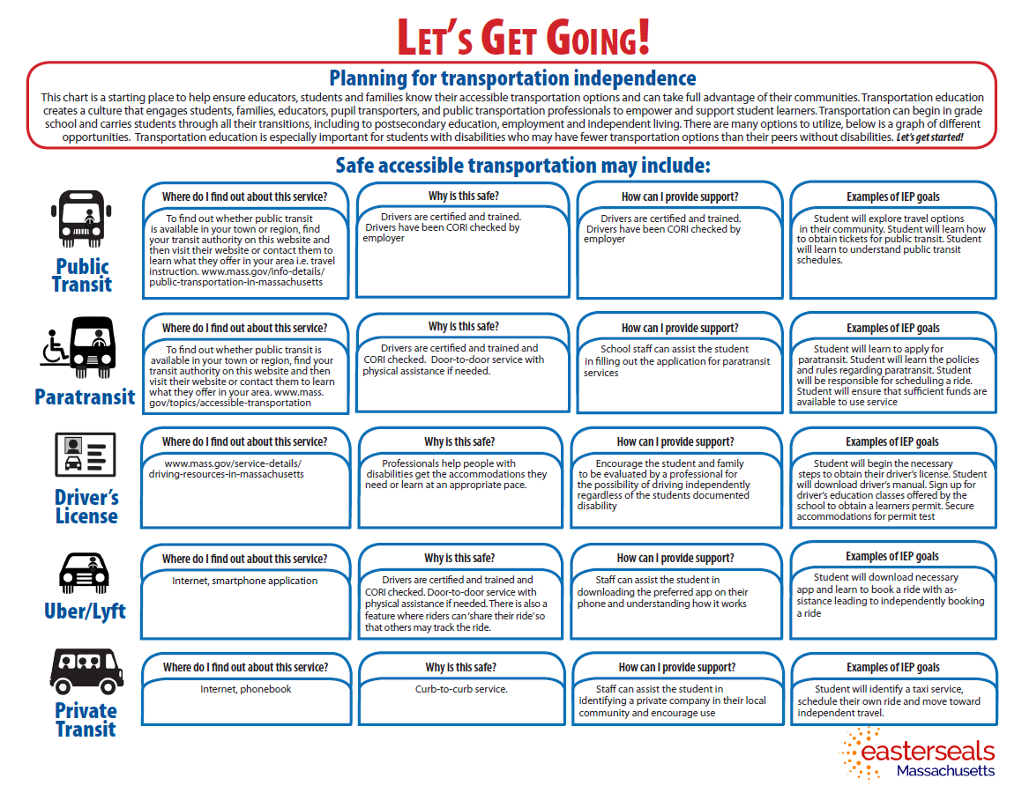
Let’s Get Going!
www.easterseals.com/ma/explore-resources/transportation/transportation-guide.html

Slide 20
Develop & implement a program
Find funding to support mobility initiatives
Tools to help you coordinate transportation with partners
Offer travel instruction
Develop a volunteer driver program
And more!
www.mass.gov/human-service-agencies-and-community-transportation

Slide 21
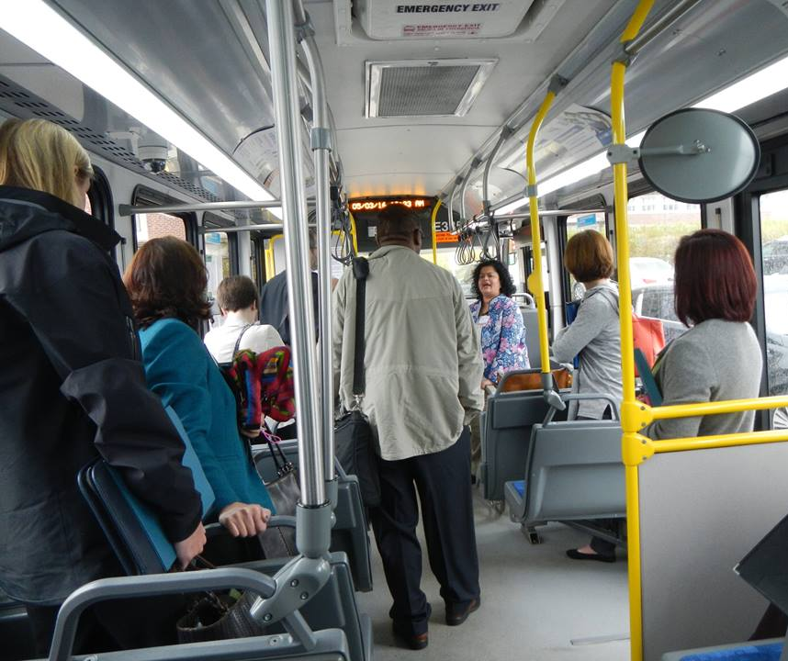
Offer travel instruction
Research & reports
  www.mass.gov/info-details/offering-travel-instruction
Professional development
  Travel Instruction Network
  Three-day introductory workshops
    www.surveymonkey.com/r/TT-intro-June2019
Technical Assistance

Slide 22



National Transportation Resources

Slide 23
Build relationships with transportation officials

Slide 24
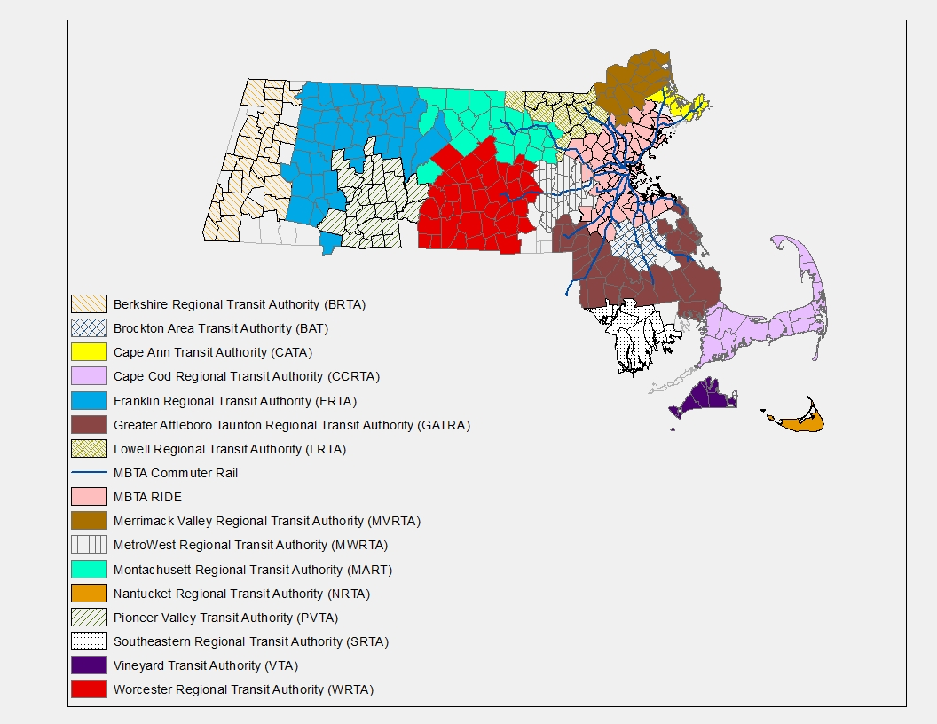

Discussion: Transportation Officials
Who to connect with?
How to connect?

Slide 25

Critical Importance of Engaging Individuals with Disabilities in Transportation Planning

Slide 26






www.acltoolkit.org

Slide 27

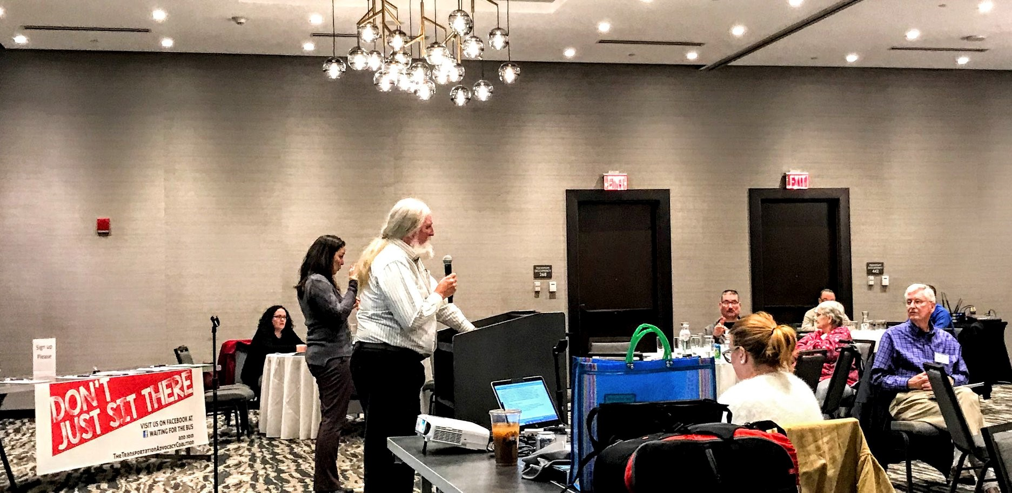
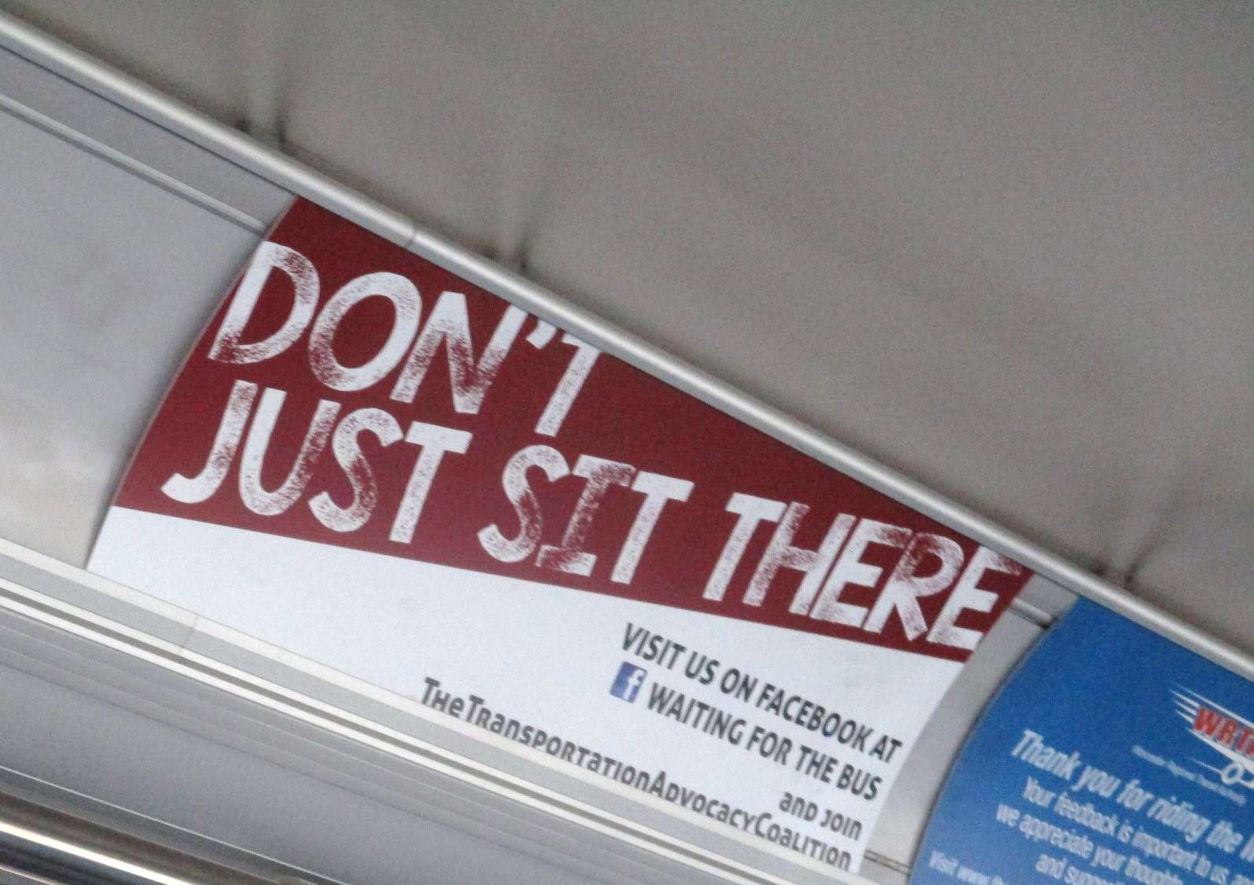
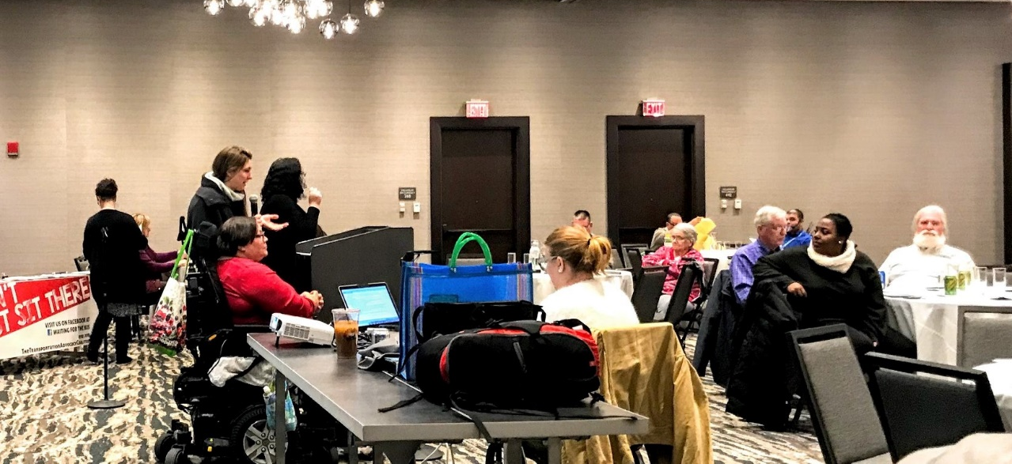

Worcester Transportation Advocacy Coalition

Slide 28
Work with other groups experiencing transportation challenges

Slide 29

Polls
Have you worked with another organization to address a transportation challenge?
  Use the chat box to tell us about your partnership
Are you a member of a Regional Coordinating Council on Transportation?

Slide 30
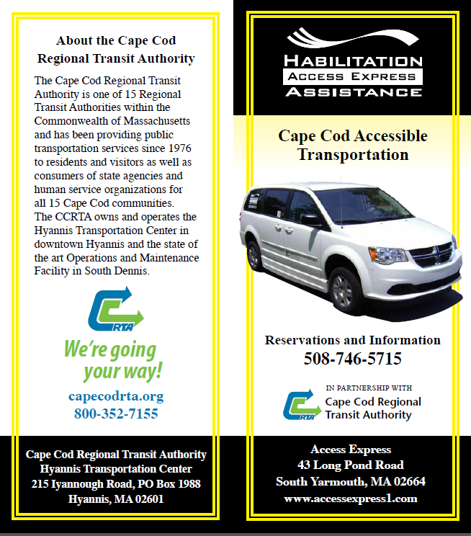
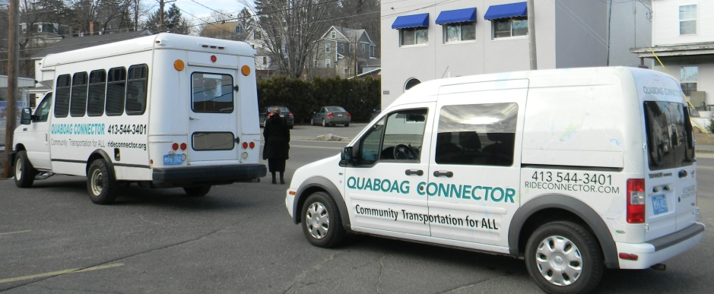
Partnering to improve mobility
    Needham van share
    Cape Cod Accessible Livery
    Quaboag Connector

Slide 31
Regional Coordinating Councils
www.mass.gov/service-details/regional-coordinating-councils-for-community-transportation

Slide 32
Use existing resources differently

Slide 33
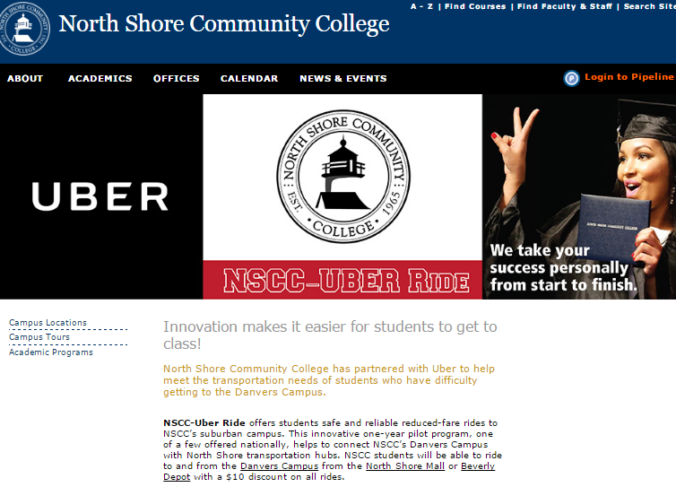
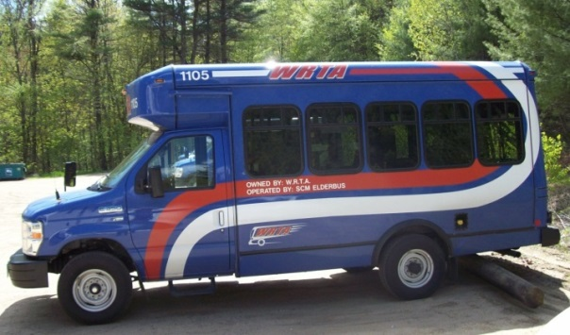
Get more from what you have
Capacity/seats
  READYBUS
Funding
  North Shore Community College

Slide 34
Answering your questions

Slide 35
Next steps

Slide 36
Want to learn more?
Join us at the 2019 MassDOT Transportation Innovation Conference
  Community Mobility Track
  April 9-10 in Worcester
  www.massdotinnovation.com
Subscribe to the monthly MassMobility newsletter
  www.mass.gov/massmobility-newsletter

Slide 37


Keep in Touch!
www.communityinclusion.org
www.employmentfirstma.org
David Hoff
david.hoff@umb.edu
www.mass.gov/orgs/massmobility
Twitter @MassMobility
Rachel Fichtenbaum
rachel.fichtenbaum@state.ma.us
Jenna Henning
jennifer.henning@state.ma.us

